Slide 1
What’s “Lazy Initialization”
An object:
might not be used ?
might not be needed immediately ?
Lazy Initialization: deferring object creation until the object is actually first used.

Slide 2
Sample Code
class Foo {
private Helper helper = null;
public Helper getHelper() {
if (helper == null)
helper = new Helper();
return helper;
}
}

Slide 3
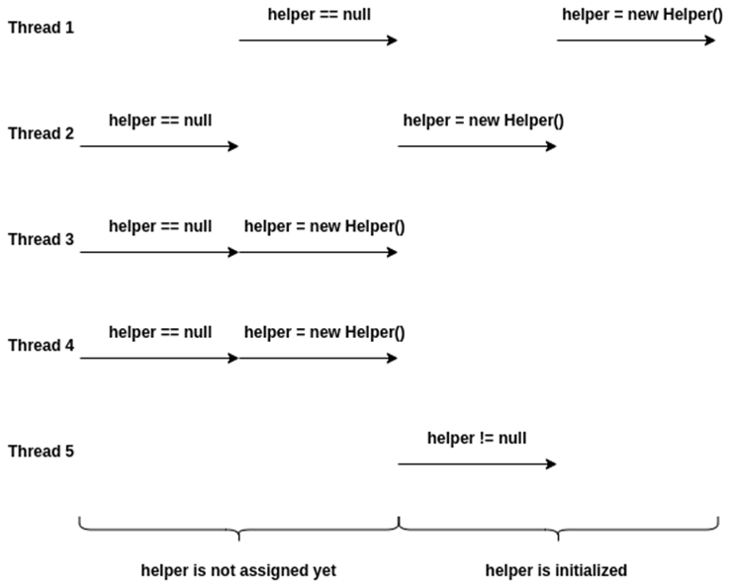
What will happen in multi-threaded environments ?
Case1:
single
processor
error
Case2:
multiple
processor

Slide 4
Solution1
class Foo {
private Helper helper = null;
public Helper getHelper() {
synchronized(this) {
if (helper == null)
helper = new Helper();
return helper;
}
}
}
critical section

Slide 5
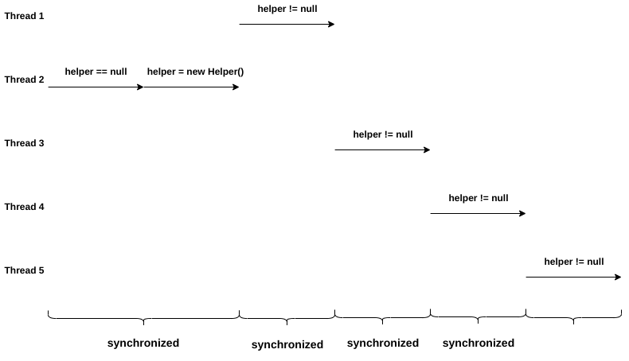
Problem
Totally serialize !

Slide 6
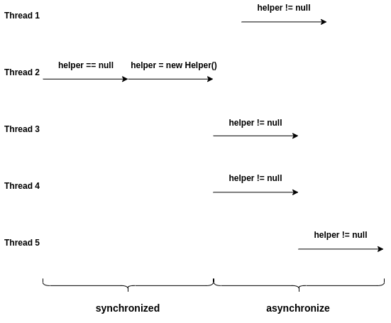
What we actually want
serialize
parallel

Slide 7
double-checked locking
class Foo {
private Helper helper = null;
public Helper getHelper() {
if (helper == null) { // first check
synchronized(this) {
if (helper == null) // second check
helper = new Helper();
}
}
return helper;
}
}

Slide 8

Perfect ? (Consider compiler, processor)
reorder the instructions
class Foo {
private Helper helper = null;
public Helper getHelper() {
if (helper == null) {
synchronized(this) {
if (helper == null)
helper = new Helper();
}
}
return helper;
}
}
not an atomic operation, consists of multiple instructions
actually
ptr = allocate();
ptr.field1 = initField1();
ptr.field2 = initField2();
helper = ptr;
Legal reordering

Slide 9
class Foo {
private Helper helper = null;
public Helper getHelper() {
if (helper == null) {
synchronized(this) {
if (helper == null) {
ptr = allocate();
helper = ptr;
ptr.field1 = initField1();
ptr.field2 = initField2();
}
}
}
return helper;
}
}

Slide 10
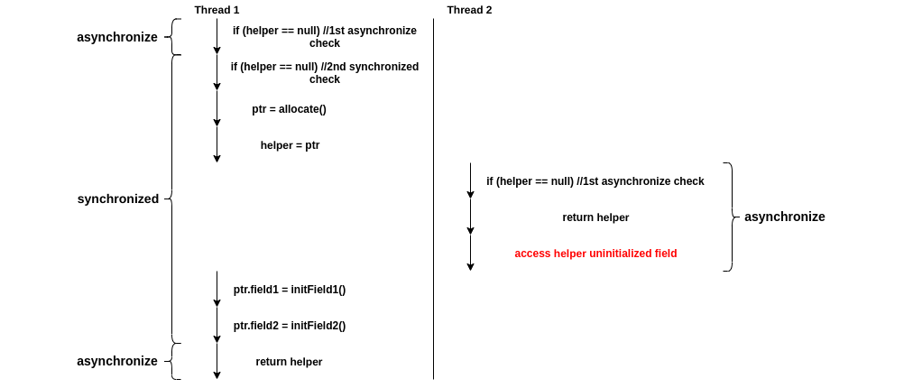
QAQ!

Slide 11
How to fix ?
1.Atomic Operation
An atomic operation will either happen completely, or it does not happen at all.
Since JDK 5, we can make reads and writes for any variable atomic by declaring it as a volatile variable.
The read/write operations of other variables after a read from a volatile variable cannot be reordered before the read from the volatile variable.
The read/write operations of other variables before a write to a volatile variable cannot be reordered after the write to the volatile variable.

Slide 12
class Foo {
private volatile Helper helper = null;
public Helper getHelper() {
if (helper == null) {
synchronized(this) {
if (helper == null)
helper = new Helper();
}
}
return helper;
}
}
Drawback: cache unfriendly
Each read and write of volatile variable will result in a memory fetch.

Slide 13
2.Explicit Memory Barrier
It is possible to make the double-checked locking actually work with an explicit memory barrier.
IN C++ 11:
std::atomic_thread_fence(std::memory_order_acquire) guarantees that read/write operations after a memory barrier cannot be reordered with read operations before the memory barrier.
std::atomic_thread_fence(std::memory_order_release) guarantees that read/write operations before a memory barrier cannot be reordered with write operations after the memory barrier.

Slide 14
class Foo {
private:
std::atomic <Helper*> helper;
public:
Helper* get_helper() {
Helper* h = helper.load(std::memory_order_relaxed);
std::atomic_thread_fence(std::memory_order_acquire); //memory barrier
if (h == nullptr) {
std::lock_guard<std::mutex> lock(m_init);
h = helper.load(std::memory_order_relaxed);
if (h == nullptr) {
h = new Helper;
std::atomic_thread_fence(std::memory_order_release);//memory barrier
helper.store(h, std::memory_order_relaxed);
}
}
return h;
}
};

Slide 15
3.Other methods … (omit)
参考链接1
参考链接2

